Slide 1
Autolaunch
Simplifying the installation experience into a customer’s AWS VPC
Notes:
Thank you for the time.
Time check
Been speaking the broader team for some time so we’re excited to have this this discussion today.
UP FRONT CONTRACT (SANDLER): Objective of today’s session is to determine if we should jointly go ahead with an evaluation of the software….
I am sure you have a lot of questions for us… we have a bunch of questions for you as well. Based on what we have done with other customers in your space: (namedrop vertical/horizontal customers)… we think we have a pretty good case to move forward… but that’s what today is all about.
Does that make sense?

Slide 2


The Case For Autolaunch on AWS
Why?
Customers are sometimes reluctant to adopt Trifacta SaaS
This could be because:
Customer is concerned about data leaving their infrastructure, due to regulations, corporate policies, or other reasons
Customer wants connectivity to data sources within their VPC
The alternative is to install Trifacta into the customer’s VPC. However, the current installation method involves many manual steps, and requires significant technical skills and time to complete
What?
Autolaunch aims to simplify the installation experience into the customer’s VPC by providing a streamlined CloudFormation template. It aims to move as close to a “One click install” as feasible.

Slide 3

Approach
How?
Simplification - Autolaunch provides an opinionated template that reduces the number of configuration parameters from 16 to 4
Automation - Autolaunch template contains an embedded script that automatically configures the Trifacta instance with S3 and EMR
As a result, a less-technical person can complete a basic installation, in a shorter amount of time
16
4
Parameters

Slide 4
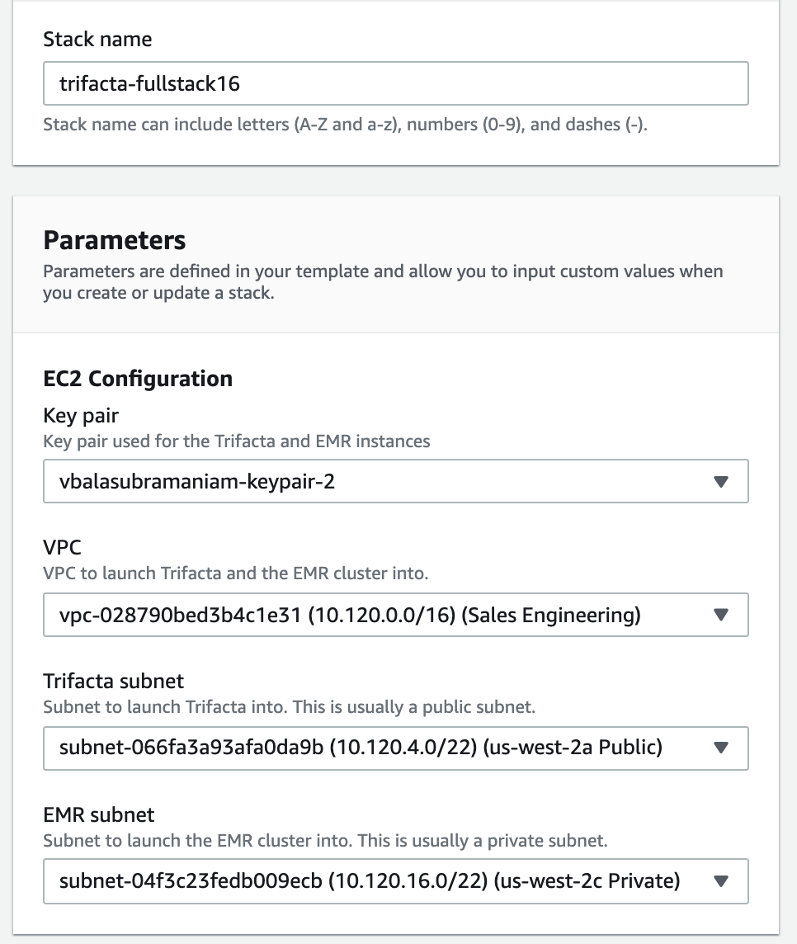
Parameters
Customer provides the following:
Existing VPC
1 public subnet (for Trifacta)
1 private subnet (for EMR)
Key pair for EC2
Several parameters from the original template have been stripped away and replaced with sensible defaults

Slide 5
Automation
Steps
CloudFormation creates resources including S3 bucket, EMR cluster, EC2 instance
A “User Data” bash script is executed when the Trifacta EC2 instance is created
Installs git and jq
Clones the git repository: https://github.com/vbalasu/trifacta-autolaunch
Executes the bash script: user-data.sh
Introspects using EC2 metadata to determine TRIFACTA_INSTANCE_ID, AWS_REGION and STACK_NAME
Uses the AWS CLI to get stack details as json
Parses the json to determine TRIFACTA_URL, TRIFACTA_BUCKET and EMR_CLUSTER_ID
Updates Trifacta platform settings (update_triconf.py) - aws.s3.bucket.name and webapp.runInEMR
Restarts Trifacta services
Calls the configuration service to set aws.s3.enabled
Calls the Trifacta REST API with the initial password (TRIFACTA_INSTANCE_ID) to obtain an API token
Uses the API token to configure EMR settings
At this point, the user can log into Trifacta, upload some data to S3 and run a Photon and Spark job

Slide 6
Additional Notes
After the installation, the Trifacta administrator can update the license file using the user interface (Admin settings)
The Autolaunch template for version 7.6 can be found here. Save this file to your computer. To use it, go to AWS console → Cloudformation → Create Stack. Choose the “Template is ready” option and upload the yaml template. Fill in the parameters as shown on pg 4 to create the stack
Template for version 8.2 will be available soon after the AWS Marketplace is updated with the latest AMIs

